Slide 1
Risk Management – part 2

Slide 2
Risk to Schedule
PERT
Program Evaluation and Review Technique.
PERT is developed to take account of the uncertainty surrounding estimates of task durations.
It is very similar to the CPM technique but instead of using one estimate for the duration of each task, it uses 3 estimates.

Slide 3
PERT
PERT's time estimation involves the beta probability distribution
to capture three estimates:
Optimistic (a) duration of an activity : the shortest time that we
expect to complete the activity,
Most likely (m) duration of an activity: the time we expect the
task to take under normal circumstances,
Pessimistic (b) duration of an activity: the worst possible time.

Slide 4
PERT combines these three duration to form a single Expected
Duration (t_{e}) = a+4m+b / 6
The expected duration (t_{e}) is used to carry out the forward pass through the network.

Slide 5
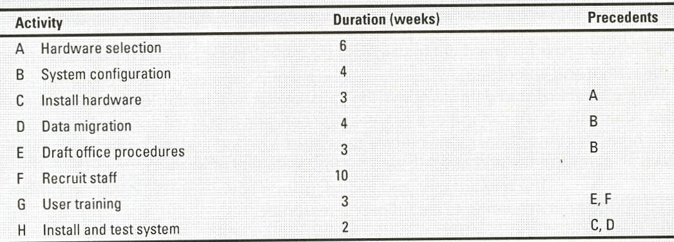
Example
(this is the information we need for the CPM)

Slide 6
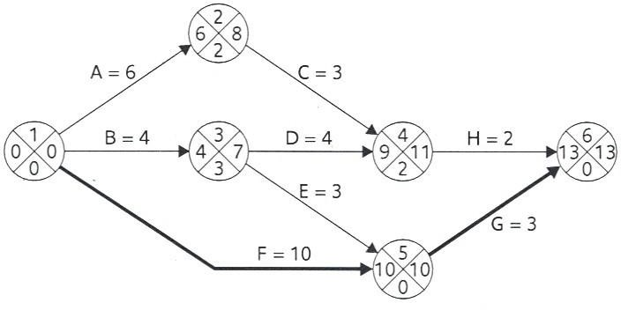
Activity-on-Arrow Network

Slide 7
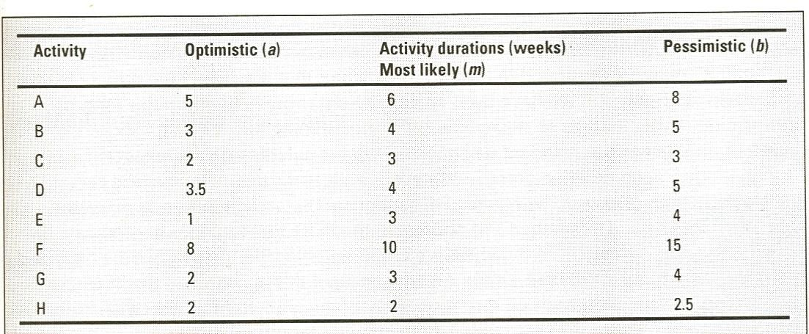
Example (PERT)

Slide 8
Activity & Event Standard Deviation
Activity Standard Deviation:
→Is a quantitative measure of the degree of uncertainty of an activity duration estimate.
It can be used as a ranking measure for the degree of uncertainty or risk for each activity.
Activity standard deviation (s) is calculated as following:
➔ S = {b – a}/ 6
➔ b: pessimistic
➔ a: optimistic

Slide 9
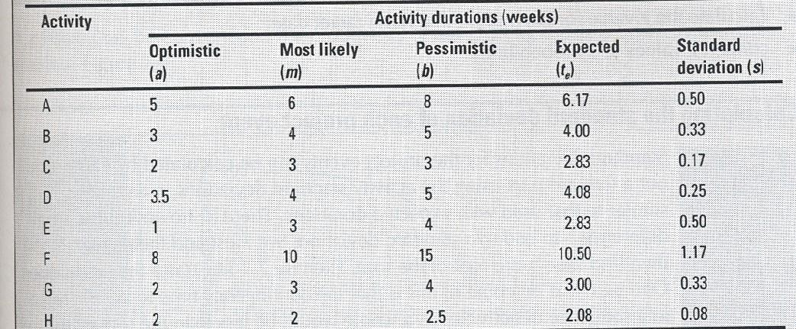
Table Showing Activity, Time Estimated and Standard Deviation

Slide 10
Risk to Schedule (cont’d)
PERT event labeling
Event Number | Target Date
Expected Date | Standard Deviation
Expected Date is the date by which we expect to achieve the event.

Slide 11
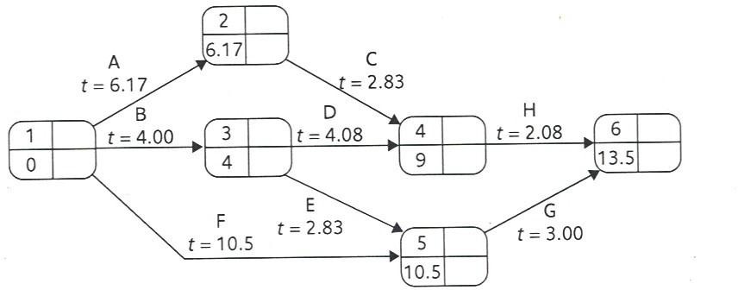
The PERT Network obtained after using the expected task durations to carry the Forward Pass and Calculating the Expected Date (events)
What does it mean that the project duration is 13.5 weeks. This means that we expect that the project will be completed halfway through week 14 but because it is an expected value it could finish earlier or later but most likely will take 13.5 weeks.

Slide 12
PERT (cont’d)
The likelihood of meeting Targets: The main advantage of the PERT technique is that it provides a method for estimating the probability of meeting or missing target dates.
We might only have on target date which is the project
completion date but….
Sometimes we would like to set intermediate dates.

Slide 13
Question
Assume the following:
We must complete the project within 15 weeks. So we will put 15 as a target date in event “6”.
In addition suppose that event “4” must end by week 10.
Event “5” must take place by week 10 as well.

Slide 14
PERT (cont’d)
The PERT technique uses the following three-step method for calculating the probability of meeting or missing a target date:
Calculate the standard deviation of each project event.
Calculate the z-value for each event that has a target value.
Convert z-values to probabilities.

Slide 15
PERT (cont’d)
Standard Deviation for each project event:
It can be calculated by carrying a forward pass using the activity standard deviations.
Adding two standard deviations = add their squares and then find the square root of the result
The standard deviation of the first event = 0
If an event depends on only one activity, the standard deviation of the event is the same as the standard deviation of the activity.
If there is more than one path we select the highest standard
deviation.

Slide 16
Table Showing Activity, Time Estimated and Standard Deviation

Slide 17
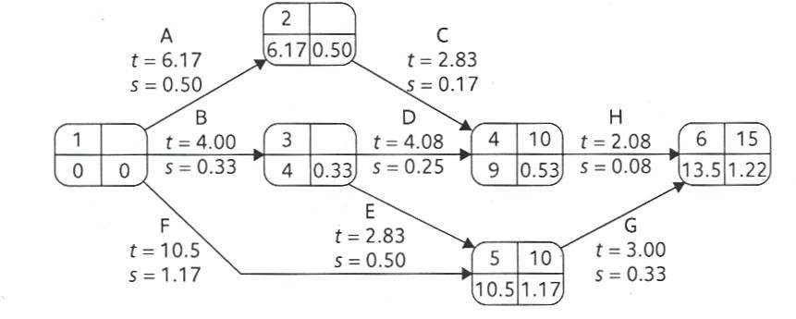
PERT Network after Calculating the Event Standard Deviations.
We assume three target Dates in the network for events 4, 5, and 6.

Slide 18
PERT (cont’d)
Calculating the (z ) values:
The z-value is calculated for each node that has a target date.
This means we can calculate it for events(4, 5, and 6).
Z = T(target date) –te (expected date) /s
For event 4, calculate Z.
Z = (10 -9) / 0.53 =1.89

Slide 19
For event 5
Z= (10-10.5)/1.17 = -0.43
Z = ( 15 - 1 3.5) /1.22 | 1 . 2
For event 6

Slide 20
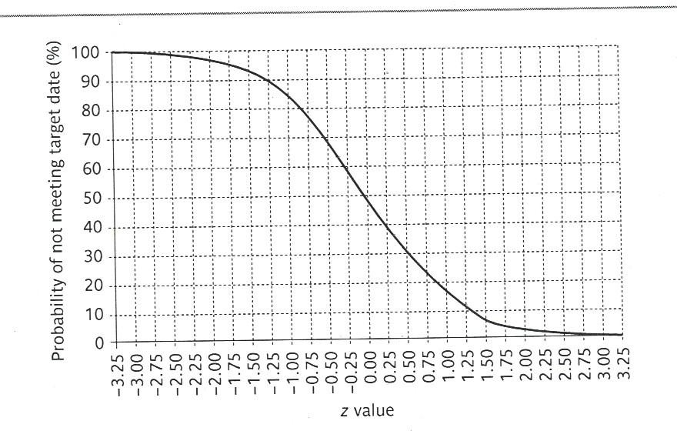
Graph for Converting z values into Probabilities
The z value can be converted into the probability of NOT meeting the
target date by using the figure above.

Slide 21
Exercise
Find the probabilities that those events will not achieve their target dates.
The z-value for event 4 is 1.89 which equate probability of approximately 3 % .
The z-value for event 5 is - 0.43 which equate probability of approximately 67 % .
The z- value for event 6 is 1.23 which equate probability of approximately 11 % .

Slide 22
